Slide 1
Low Res Frameworks

Slide 2
Title
Temp
Bio
Title
Temp
Bio
Dropdown
Dropdown
Images of city
Images of city
Images
Images
Video
Video
DESKTOP VIEW
TABLET VIEW

Slide 3
Title/Temp/Bio
Dropdown
Images
Images
Video
PHONE VIEW

Slide 4
High Res Frameworks

Slide 5
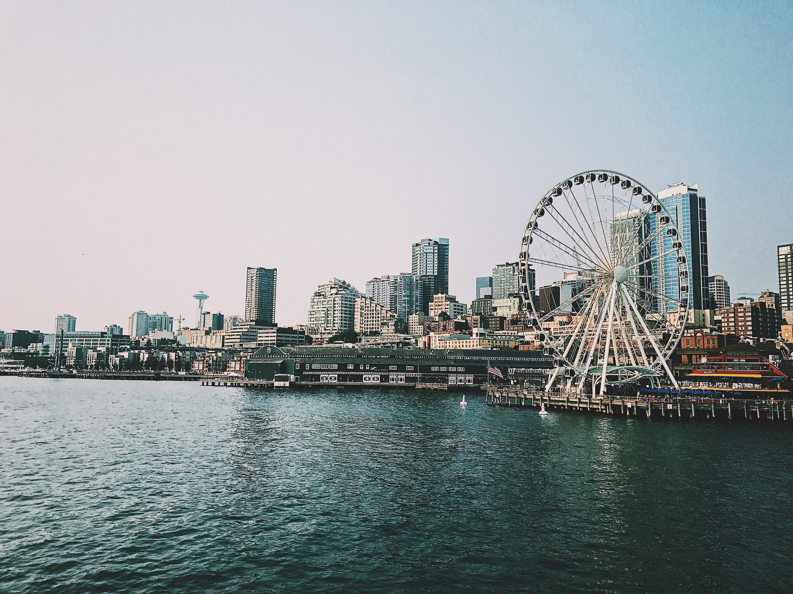
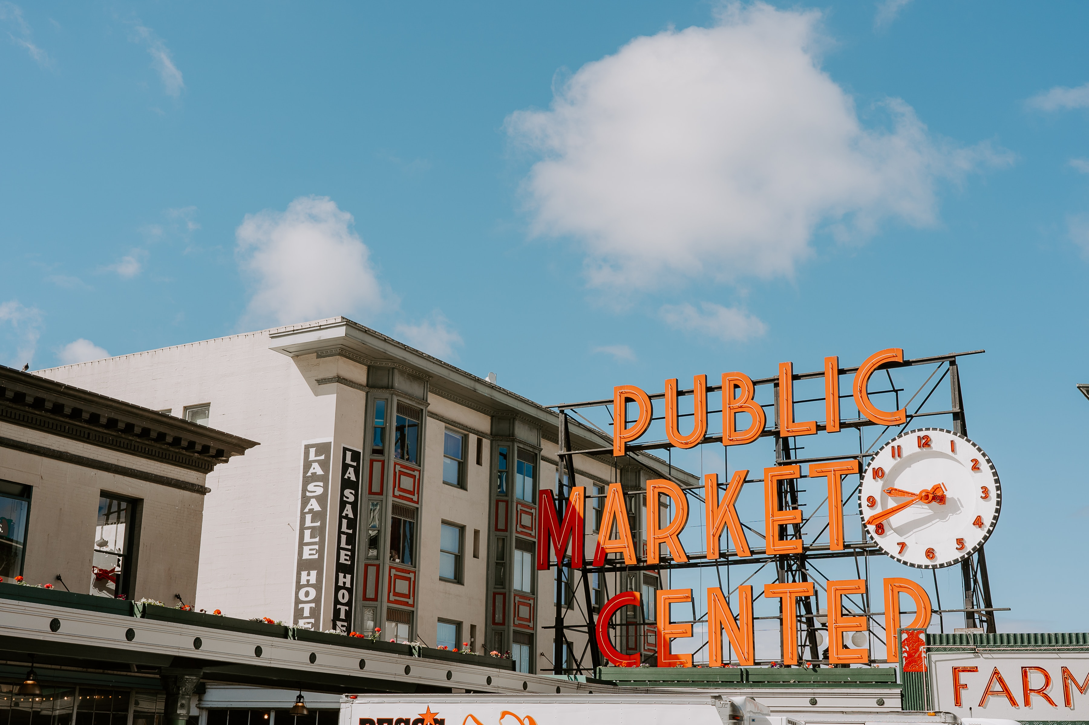
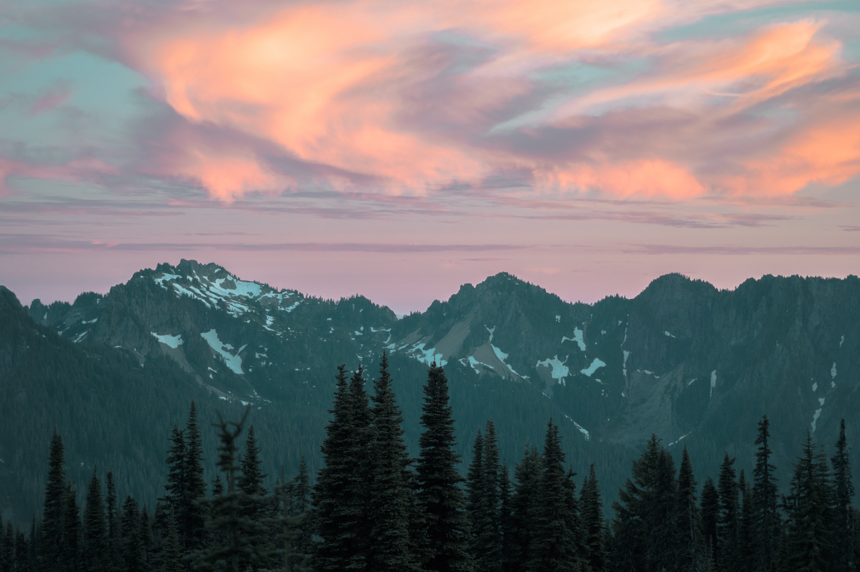
WELCOME TO SEATTLE
85 | 26
The new town's principal economic support was Henry Yesler's lumber mill at the foot of Mill Street (now Yesler Way), built in 1853. Much of the mill's production went to the booming city of San Francisco, but the mill also supplied the fledgling towns throughout the Puget Sound region. A first failed attempt at incorporation lasted from 1865 to 1867. The official incorporation of Seattle was by the Territorial legislature on December 2, 1869; Seattle had more than 2,000 residents. Washington would not become the 42nd state until 20 years later in 1889.
Dropdown
Embedded Video
DESKTOP VIEW

Slide 6
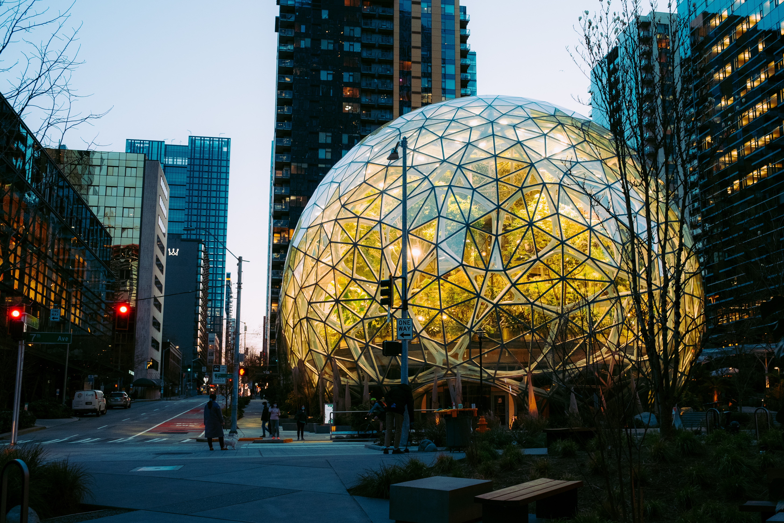
WELCOME TO SEATTLE
WELCOME TO SEATTLE
85 | 26
85 | 26
The new town's principal economic support was Henry Yesler's lumber mill at the foot of Mill Street (now Yesler Way), built in 1853. Much of the mill's production went to the booming city of San Francisco, but the mill also supplied the fledgling towns throughout the Puget Sound region. A first failed attempt at incorporation lasted from 1865 to 1867. The official incorporation of Seattle was by the Territorial legislature on December 2, 1869; Seattle had more than 2,000 residents. Washington would not become the 42nd state until 20 years later in 1889.
The new town's principal economic support was Henry Yesler's lumber mill at the foot of Mill Street (now Yesler Way), built in 1853. Much of the mill's production went to the booming city of San Francisco, but the mill also supplied the fledgling towns throughout the Puget Sound region.
Dropdown
Dropdown
Video
Video
TABLET VIEW
PHONE VIEW

